Slide 1

8th Grade Math: Pre-Algebra
Unit 1, Lesson 1 Rewriting Rational Numbers in Equivalent Forms Volume 1, pg. 7

Slide 2


Benchmark
MA.7.NSO.1.2
Rewrite rational numbers in different but equivalent forms including fractions, mixed numbers, repeating decimals, and percentages to solve mathematical and real-world problems.
volume 1, pg. 7

Slide 3
Integrated Mathematical Thinking and Reasoning Standards
MA.K12.MTR.3.1 Complete tasks with mathematical fluency.
MA.K12.MTR.4.1 Engage in discussions that reflect on the mathematical thinking of self and others.
MA.K12.MTR.5.1 Use patterns and structure to help understand and connect mathematical concepts.
volume 1, pg. 7

Slide 4

Learning Target
I can rewrite rational numbers in different but equivalent forms.
volume 1, pg. 7

Slide 5

Warm-Up
volume 1, pg. 7

Slide 6
1.1.1 Warm-Up: Day at Work: Senior Designer
Nik Brensnick is a senior product designer. She is quoted as saying, “A big part of working and being successful in the workplace has to do with cultivating relationships with other people.”
Why do you think Nik has this belief about being successful in the workplace?
volume 1, pg. 7

Slide 7

Activity
volume 1, pg. 8

Slide 8

1.1.2 Activity: Match It Up!
Work with your partner to match the equivalent rational numbers expressed in different forms. Record each matching set in the table.
Fraction | Decimal | Percent
volume 1, pg. 8

Slide 9
Explain your method for matching the equivalent rational forms.
volume 1, pg. 8

Slide 10

Guided Practice
volume 1, pg. 8

Slide 11


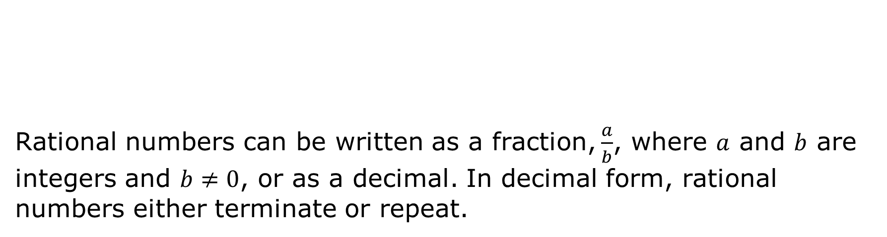
1.1.3 Guided Practice: Repeating Decimals
Rational numbers can be written as a fraction, $\frac{a}{b}$, where $a$ and $b$ are integers and $b≠0$, or as a decimal. In decimal form, rational numbers either terminate or repeat.
A rational number is a real number that can be expressed as a ratio of two integers.
volume 1, pg. 8

Slide 12
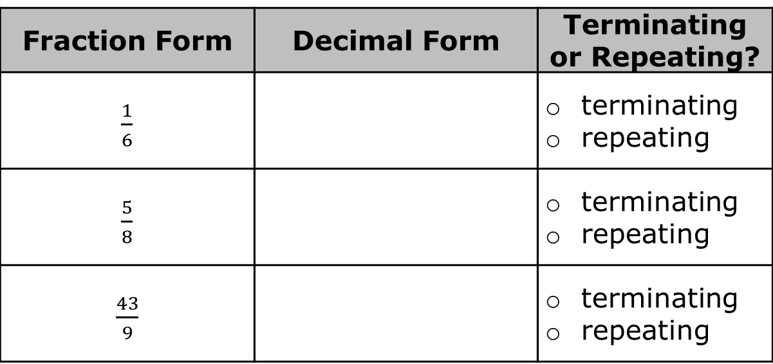
Consider the fractions in the table shown.
Complete the table by rewriting each fraction into its equivalent form. If a decimal repeats digits in a pattern, use an ellipse (...) to indicate that the pattern continues.
Based on your work in Part A, explain whether it is possible for a repeating decimal to ever terminate.
Fraction Form | Decimal Form | Terminating or Repeating?
$\frac{1}{6}$ |  | terminating repeating
$\frac{5}{8}$ |  | terminating repeating
$\frac{43}{9}$ |  | terminating repeating
volume 1, pg. 8

Slide 13

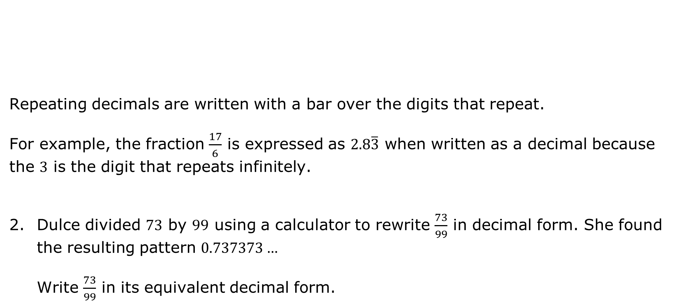
Repeating decimals are written with a bar over the digits that repeat.
For example, the fraction $\frac{17}{6}$ is expressed as $2.8\overline{3}$ when written as a decimal because the $3$ is the digit that repeats infinitely.
Dulce divided $73$ by $99$ using a calculator to rewrite $\frac{73}{99}$ in decimal form. She found the resulting pattern $0.737373…$
Write $\frac{73}{99}$ in its equivalent decimal form.
A number with a decimal that never ends, but has a pattern that repeats infinitely, is called a repeating decimal.
volume 1, pg. 9

Slide 14

Guided Instruction
volume 1, pg. 9

Slide 15
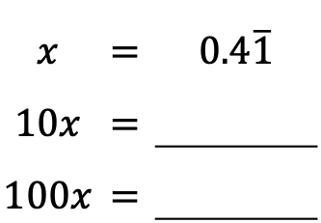
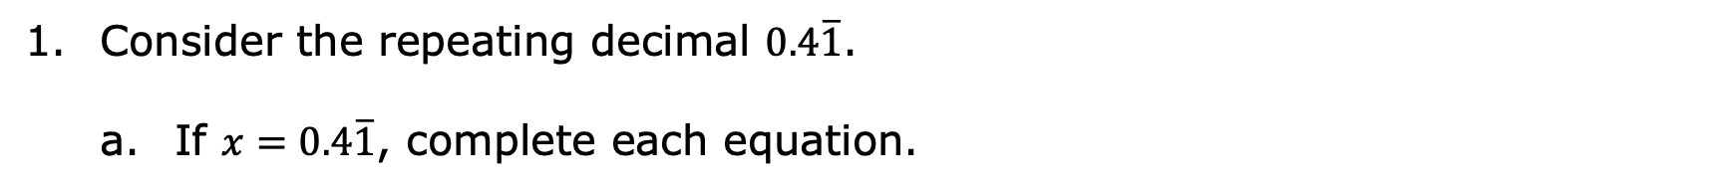
1.1.4 Guided Instruction: Rewriting Repeating Decimals as Fractions
Consider the repeating decimal $0.4\overline{1}$.
If $x=0.4\overline{1}$, complete each equation.
$$x$$ | $$=$$ | $0.4\overline{1}$
$$10x$$ | $$=$$
$$100x$$ | $$=$$
Which two values, when subtracted, would result in the elimination of the repeating portion of the decimal?
volume 1, pg. 9

Slide 16
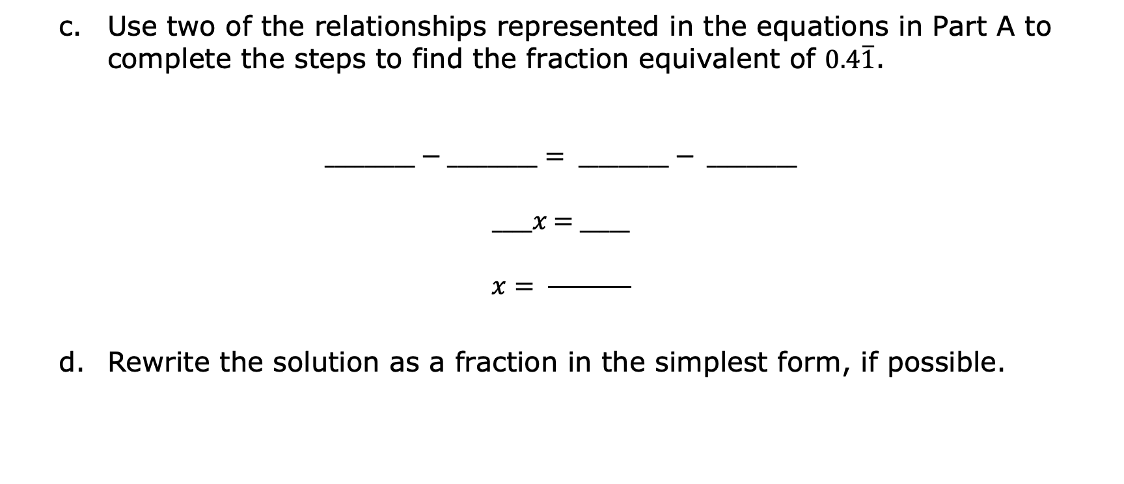
Use two of the relationships represented in the equations in Part A to complete the steps to find the fraction equivalent of $0.4\overline{1}$.
$$_________−_________= _________− _________$$
____$x$ = _____
$$x= \frac{ }{ }$$
Rewrite the solution as a fraction in the simplest form, if possible.
volume 1, pg. 9

Slide 17

Try It
volume 1, pg. 10

Slide 18

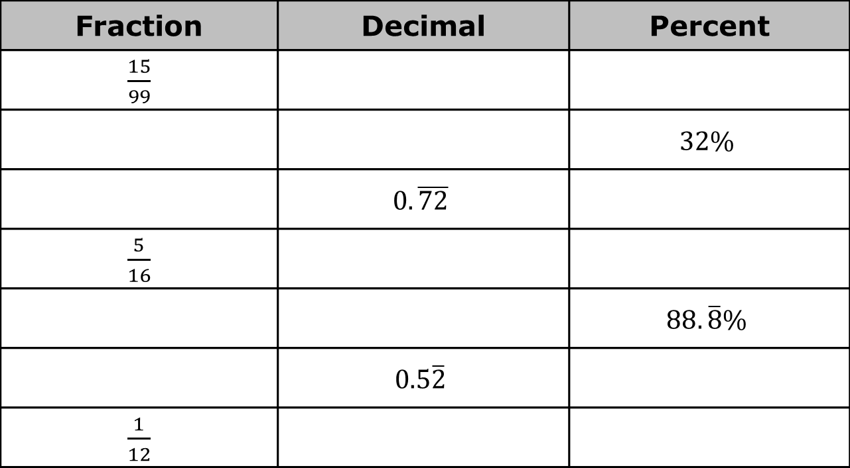
1.1.5 Try It: Equivalent Forms
Complete the table.
Fraction | Decimal | Percent
$\frac{15}{99}$
 |  | $$32\%$$
 | $$0.\overline{72}$$
$\frac{5}{16}$
 |  | $$88.\overline{8}\%$$
 | $$0.5\overline{2}$$
$\frac{1}{12}$
volume 1, pg. 10

Slide 19

Wrap-Up
volume 1, pg. 10

Slide 20
1.1.6 Wrap-Up: Reflection
Check all the statements that apply to your understanding.
I understand how to rewrite rational numbers in different but equivalent forms.
I need support on how to rewrite rational numbers in different but equivalent forms.
I understand how to convert a repeating decimal to a fraction.
I need support on how to convert a repeating decimal to a fraction.
volume 1, pg. 10

